Slide 1
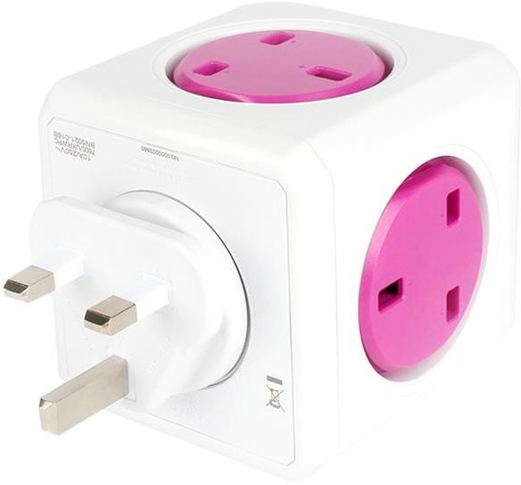


Building APIs
with the OpenAPI Spec
Dr. Pedro J. Molina
CEO at Metadev @pmolinam

Slide 2




What’s common here?
Ecosystems
Library 1
API
Library 2
Shop N
API
Service 1
Service 2
Service N
API
mLab
SendGrid
Plugin N

Slide 3



Pedro J. Molina
@pmolinam

Slide 4

Agenda
API Economy
OpenAPI
User Cases
Versioning
Future

Slide 5

Application Programmer Interface
Services ready for 3er parties to consume
Technical Description (dev. oriented)
Promotes system integration by clear contracts durable in time

Slide 6

API Economy
APIs define plataforms.
Twitter, Twilio, Google Maps as API samples.
You can’t win without an ecosystem.
You can’t have an ecosystem without an API.
First one take it all → market share

Slide 7

API as a contract with customers
API

Slide 8
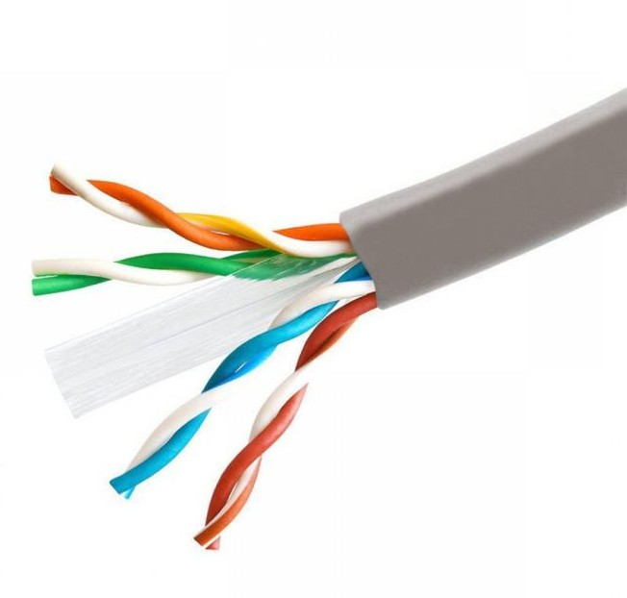

Language agnostic APIs
1. CORBA | >> | C + IDL
2. SOA | >> | XML + SOAP + WDSL …
3. REST | >> | JSON + HTTP

Slide 9

OpenAPI Initiative
De facto standard (previously: Swagger)
Linux Foundation https://www.openapis.org
Formal contract description for a REST API useful for both humans and machines.
Contract described in JSON or YAML

Slide 10
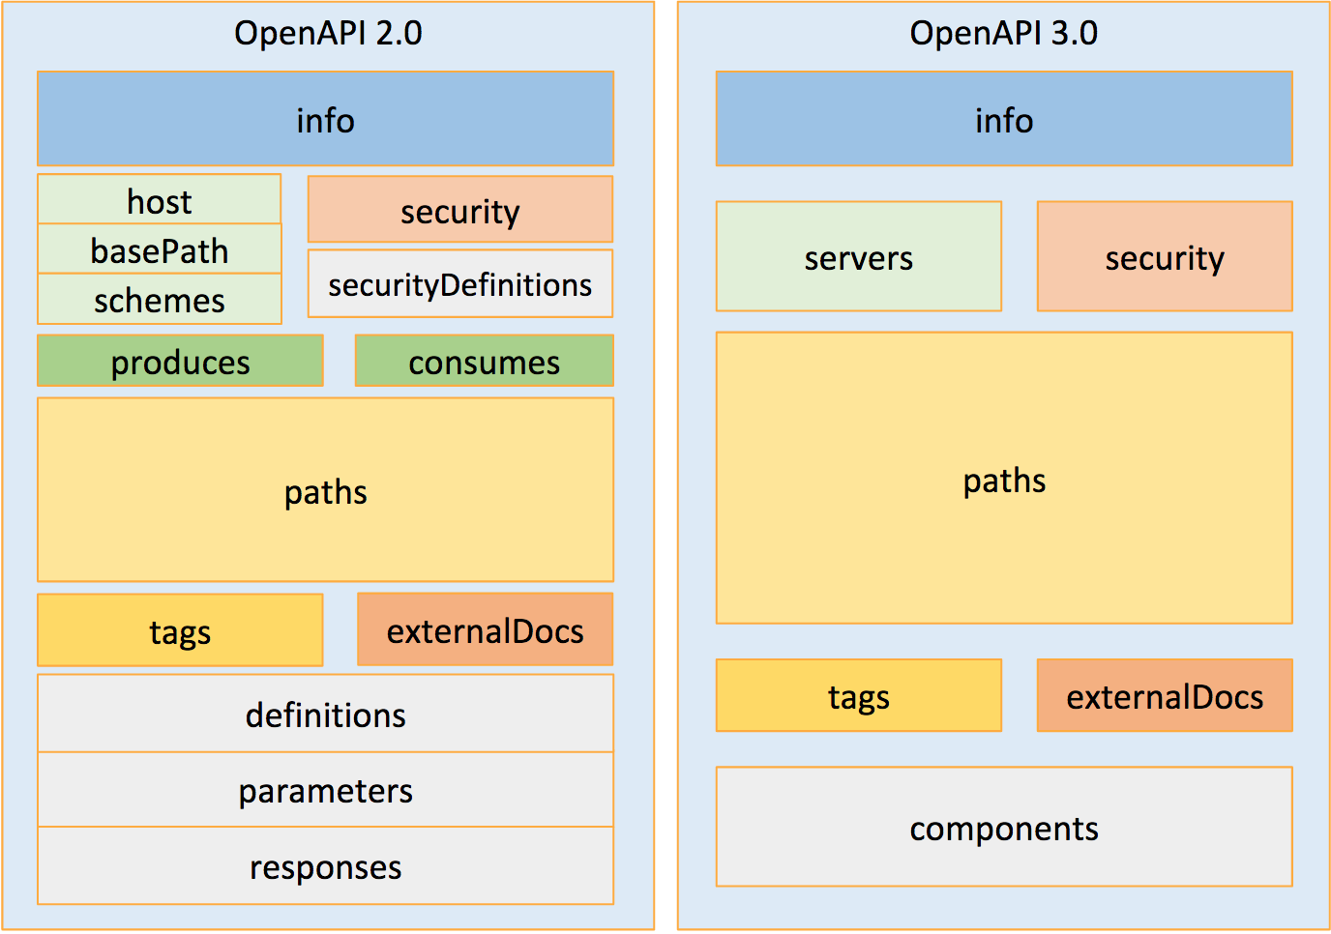

Slide 11
OpenAPI Initiative
Tooling
Editor
API Explorer
Validator
http://editor.swagger.io http://petstore.swagger.io
https://online.swagger.io/validator
Opensource Generators:
skeletons for back-ends
proxies for front-end
http://swagger.io/swagger-codegen

Slide 12
Use cases
Legacy API
Contract First
Service driven

Slide 13

1. Legacy API
API
Document an existing API
Contract creation http://editor.swagger.io
Validation
Results:
API docs
SDK generation for clients

Slide 14
1. Legacy API. Sample
API
Is Nieves a girl’s or boy’s name?
Web service to discover it:
http://www.jerolba.com/mujeres-y-hombres-y-serverless
GET https://us-central1-hombre-o-mujer.cloudfunctions.net/gender?name=nieves Credits to: Jerónimo López @jerolba

Slide 15
1. Legacy API. Contract
API
http://bit.ly/gender-swagger
swagger: '2.0'
info:
version: "1.0.0"
title: Girl or boy.
host: us-central1-hombre-o-mujer.cloudfunctions.net schemes:
https
consumes:
application/json produces:
application/json
tags:
name: Gender
description: Frequency name based API to guest gender.

Slide 16
1. Legacy API. Contract
API
paths:
/gender: get:
description: |
Returns the probability base on gender frequency on registed names in Spain.
parameters:
- name: name in: query
description: Given name required: true
type: string
responses:
# Response code 200:
description: Sucessful response schema:
$ref: "#/definitions/GenderResponse"
404:
description: Not found schema:
$ref: "#/definitions/GenderNotFoundResponse"

Slide 17
1. Legacy API. Contract
API
definitions:
GenderResponse:
required:
name
gender
probability
totalMale
totalFemale properties:
name:
type: string
gender:
type: string probability:
type: number
format: float
totalMale: type: number format: int32
totalFemale: type: number format: int32
GenderNotFoundResponse:
required:
name
gender
properties:
name:
type: string gender:
type: string

Slide 18
2. Contract First
API
Client
Spec is written in first place
http://editor.swagger.io
Can generate:
a skeleton for backend
a proxy or SDK for consumers
enables parallel work on backend and frontend teams.
contract change can be versioned in a proper way.

Slide 19
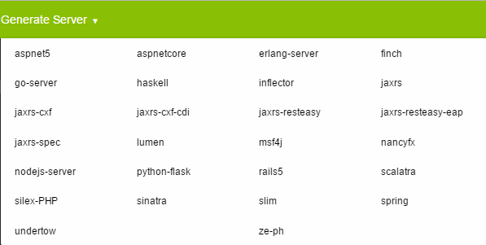
2. Contract First. Available server stacks

Slide 20
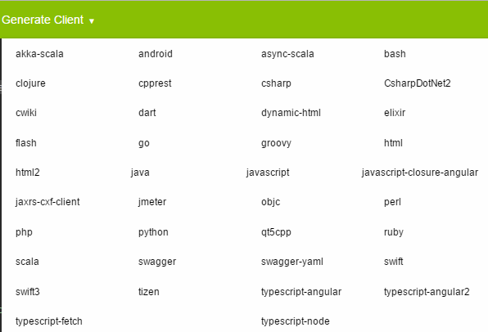
2. Contract First. Available front-end stacks

Slide 21

Swagger/code-gen
Migrating from spec v.2 to v.3
Book about how to extend swagger/code-gen for your language/stack:
http://bit.ly/codegen101

Slide 22
3. Service Driven
API
Client
The Service defines the contract
The OpenAPI spec is generated by a library using reflection over the service.
Requires taking special care to NOT TO break the API compatibility.
Sample: https://openapi3.herokuapp.com
Source: https://github.com/pjmolina/event-backend

Slide 23
Resources
Maintainer of:
baucis-swagger2 Generates v.2 contracts for Baucis backends
https://www.npmjs.com/package/baucis-swagger2
baucis-openapi3 Generates v.3 contracts for Baucis backends
https://www.npmjs.com/package/baucis-openapi3
openapi3-ts TypeScript library for building OpenAPI3 documents
https://www.npmjs.com/package/openapi3-ts

Slide 24
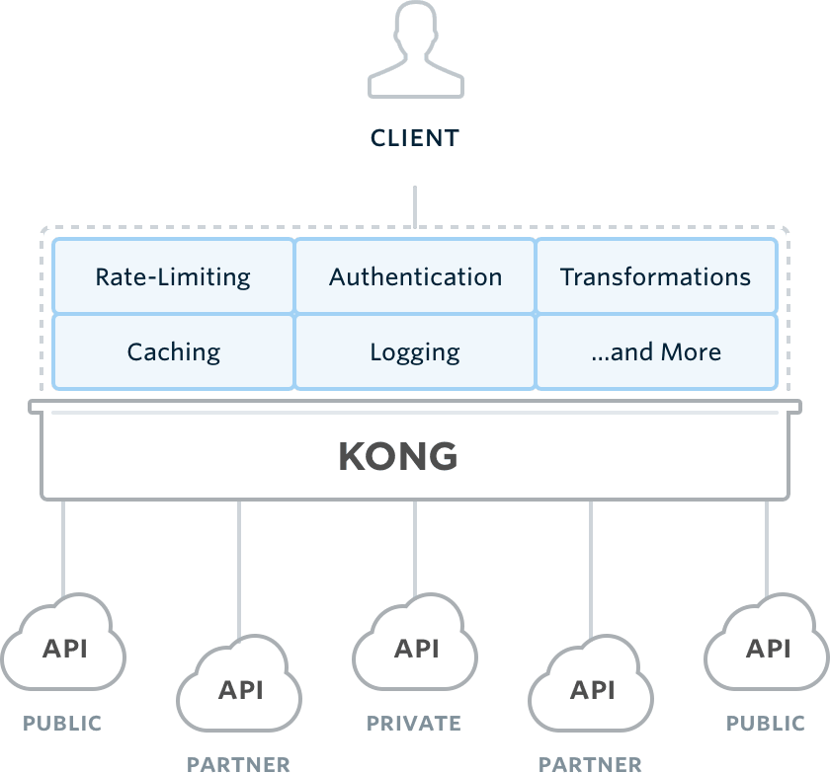
API Management Tools

Slide 25
API Management Tools
Provides an extra layer in front of your API
Managed by 3er parties (externalized)
Main features:
Authentication, Authorization
Role-based security
DOS attack protection
Monetization: pay per use
Scaling
Auditing
Usage metrics, analytics
Examples
3scale
Apigee
Mashape Kong
CA 7Layers
Azure API Management
IBM Bluemix API
Management
WSO

Slide 26
API Versioning
Versioning via URL
GET /v1/restaurants?location=SVQ
GET /v2/restaurants?location=SVQ&limit=30
Versioning via parameter
GET /restaurants?location=SVQ&limit=30&v=2
Versioning via headers
GET /restaurants?location=SVQ&limit=30
Version: 2

Slide 27
API Scalability
Stateless API
Load-balancer to handle traffic
api #0
(e.g. nginx or ha-proxy)
Distributes traffic to your API
servers
80
443
lb
api #1
DNS, SSL and certs. configured in
the load balancer
api #2

Slide 28

Summing up
OpenAPI is a de-facto standard to manage APIs
Simplifies consumption and API integration
Version 3.0 released in June 2017
Roadmap:
Swagger-codegen porting from v.2 to v.3 (work in progress)
Convergence with Google gRPC

Slide 29
Thx!
@pmolinam

Slide 30
Questions?
@pmolinam

Slide 31


Your ideas in action
https://metadev.pro
| @metad3v

Slide 32
Extra bonus

Slide 33
REST
REpresentational State Transfer
Stateless Protocol
Unique URIs per resource
Semantic attached to operations/verbs
GET/PUT/POST/DELETE over HTTP
Hypermedia (navigable)
GET /actors/42
Accept: application/json
200 OK
Content-Type: application/json
{ "id": 42
"name": "Jessica" "lastname": "Alba" "filmography": "/films/42"
}

Slide 34
MIME Types
Declares encoding
GET /actors/42
Accept: text/xml
Most frequents are:
JSON
XML
HTML
Plain text
CSV
application/json text/xml text/html text/plain text/csv
200 OK
Content-Type: text/xml
<actor id="42">
<name>Jessica</name>
<lastname>Alba</lastname>
<filmography
url= "/films/42" />
</actor>

Slide 35
REST Levels
Richarson Maturity Model
http://martinfowler.com/articles/richardsonMaturityModel.html
Level 0. HTTP and nothing else (RPC under HTTP)
Level 1. Resources
Level 2. Using the semantinc of verbs and HTTP error codes https://i.stack.imgur.com/whhD1.png https://httpstatuses.com
GET /invoice/217
POST /invoice/ → 201 Created
Level 3. Hypermedia Controls
<link rel=“lines”
uri=“/factura/217/lineas”/>

Slide 36

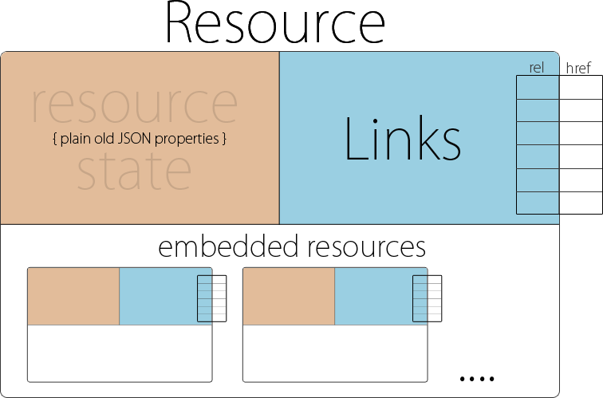
://
HAL
{
“id”: 1234
“name”: “Alice in Wonderland”
“_links”: {
“self”: { “href”: “/book/10”},
“prev”: { “href”: “/book/9”},
“next”: { “href”: “/book/11”}, “action-delete”: {
“verb”: “DELETE”,
“href”: “/book/10”
}
}
}

